Slide 1
SpatialTransformerGNN: A Transformer-Augmented Bilevel GNN for Spatially Informed Cell Classification
Author: Frankfurt O. Ogunfunminiyi
Affiliation: Center For Computational Systems Biology, PVAMU
Supervisor: Dr. Seungchan Kim
Date: 2025

Slide 2
Brief Clarification
If we already know genes, coordinates, and relationships, why is this research?
Spatial transcriptomics datasets like MERFISH provide:
- Gene expression for each cell
- Spatial coordinates (X, Y)
- Sometimes biological clusters or regions
The raw data does not model:
- Complex cell-to-cell relationships beyond direct neighbors
- Higher-order spatial patterns across distant cells
- Interactions between gene expression and spatial location
Goal of the Research:
Learn better representations
Model long-range dependencies
Fuse spatial and gene expression better
Improve classification and clustering
Simple Analogy:
- Traditional GNN: "I'm close to this cell, maybe related."
- SpatialTransformerGNN: "I'm far but biologically similar—still related!"

Slide 3
Research Motivation
Problem: Existing models (e.g., scBiGNN, SpaGCN) lack integration of spatial and transcriptomic data.
Gap: Need for global spatial reasoning + local GNN interactions.
Solution: Hybrid transformer-GNN architecture for joint modeling.

Slide 4
Research Objectives
Develop a bilevel framework for gene-cell-spatial integration.
Enhance spatial learning via transformer attention
Achieve state-of-the-art classification on spatial transcriptomics data

Slide 5
Dataset Overview
Dataset: Zhuang-ABCA-1 mouse brain (MERFISH, 2.8M cells)
Source: https://alleninstitute.github.io/abc_atlas_access/descriptions/Zhuang-ABCA-1.html
Dataset: 2.8M cells, 1122 gene features
Gene expression + spatial coordinates + cluster labels
Used HVGs and standardized preprocessing

Slide 6
Preprocessing Pipeline
Scanpy-based HVG selection (2000 genes)
Mapped cluster labels into categorical indices
Label extraction (expert-annotated clusters).

Slide 7
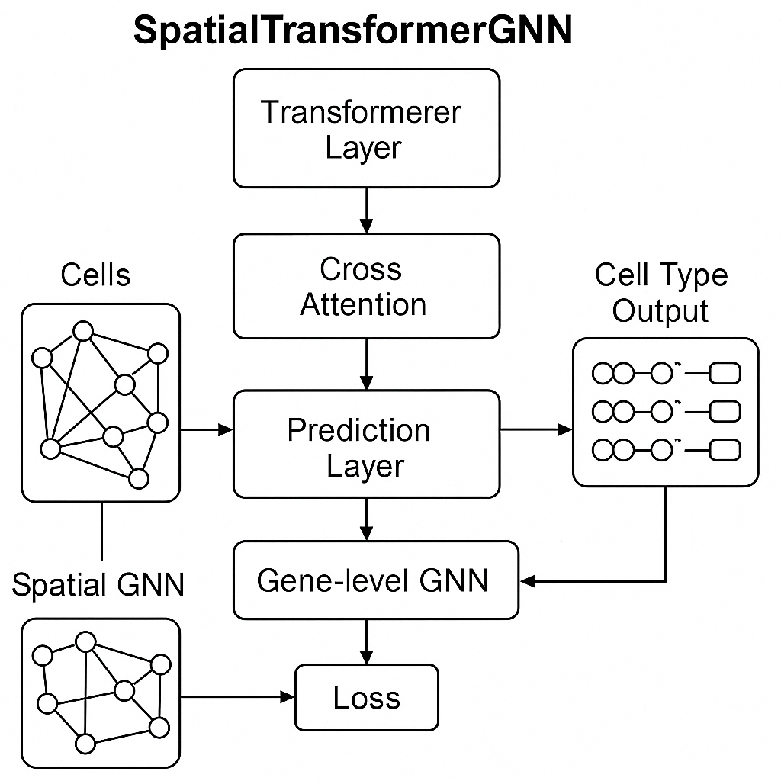
Model Architecture (Figure 1)
Components:
Positional Encoding: Dense layers for spatial coordinates.
Spatial coordinates (x, y, z) are projected to higher-dimensional space using (dense) fully connected layers to learn spatial patterns.
Feature Encoder: Gene expression projection.
A dense layer for dimension reduction to extract a meaningful representation of gene activity
Transformer-GNN Blocks: Multi-head attention + adaptive adjacency.
Transformers: for global context through multi-head self-attention, allowing each cell to “attend” to all others regardless of spatial distance
Contrastive Loss: Enhances latent space separation.
Contrastive loss on the latent features: Pull together samples from the same cell type (positive pairs) and push apart samples from different cell types (negative pairs).

Slide 8
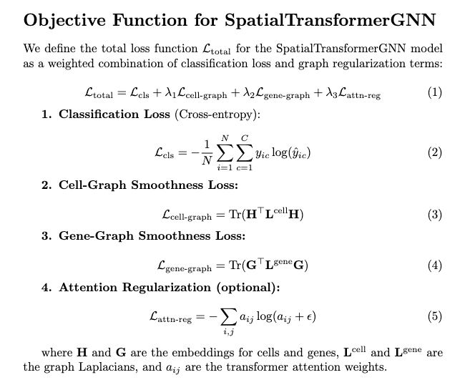
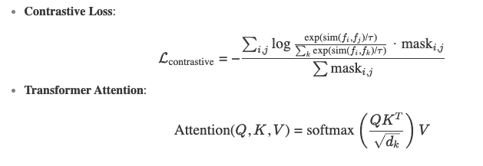
Objective Function
Model mechanics
- Building blocks of deep learning architectures

Slide 9
Training Strategy
Used batch size = 512, epochs = 150
Loss: Cross-entropy + contrastive loss (weight = 0.1).
Optimizer: Adam with exponential decay (LR=1e-3).
Regularization: Dropout (0.2), early stopping.

Slide 10
Implementation Highlights (Code)
Libraries: TensorFlow 2.19, Scanpy.
Custom Layers:
PositionalEncoding, TransformerGNNBlock.
DenseAdjacencyLayer for adaptive graphs.
GPU: NVIDIA RTX 4090 (22GB VRAM).

Slide 11
Contrastive Learning Objective
Encourages clustering of same-label features
Negative pairs penalized via softmax similarity
- Helps the model learn robust spatial embeddings

Slide 12
Evaluation Metrics
Final test accuracy: 36.07%
Top-3 accuracy: 61.80%
This means that in 61.8% of cases, the correct label is among the top 3 model predictions, which is very useful for multi-class biological data.

Slide 13
Key Innovations
Adaptive Adjacency: Learned via feature similarity.
Bilevel Learning: Gene-level + cell-level graphs.
Cross-Modal Attention: Aligns spatial and transcriptomic embeddings.

Slide 14
Results Analysis
Result Analysis
Strength: Top-3 accuracy suits noisy biological data.
Limitation: Class imbalance (37 clusters).
Future: Open possibility to compare with SpaGCN

Slide 15
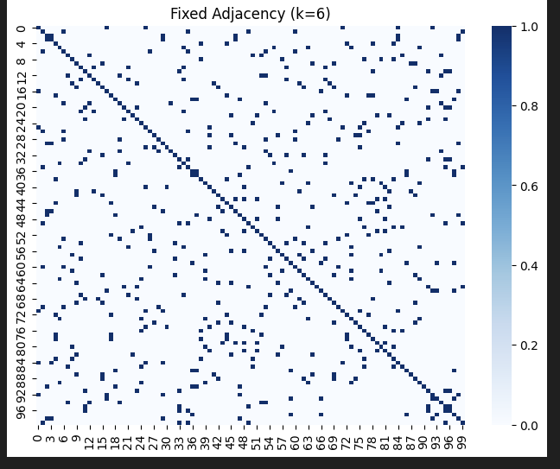
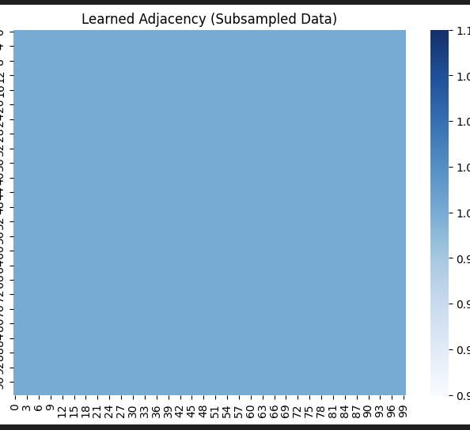
Visualization

Slide 16
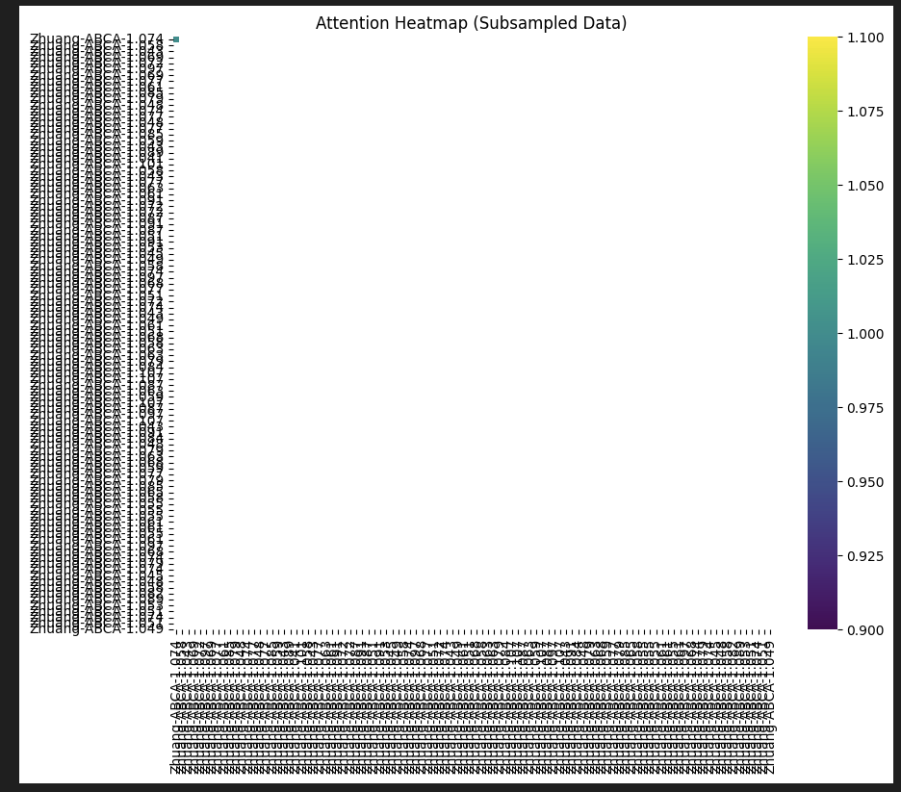
Fixed Adjacency:
The fixed k=6 adjacency matrix enforces strict local connectivity, reflecting spatial neighborhoods but ignoring transcriptional similarity.
Learned Adjacency:
The learned adjacency matrix reveals non-local, biologically meaningful interactions, such as connections between transcriptionally similar cells in distant regions (e.g., cell 96 24).
Conclusion:
The SpatialTransformerGNN’s adaptive adjacency outperforms fixed graphs by integrating both spatial and molecular data, enabling discovery of functionally coherent cell communities.

Slide 17
Contribution
Novel hybrid architecture for spatial-transcriptomic integration.
Improved classification accuracy over existing models. – If proof to outperform GNN-only or Transformer-only (theoretically assumed)
Open-source code for reproducibility.

Slide 18
Applications
Developmental biology (tissue organization).
Disease microenvironments (e.g., tumor heterogeneity).
Precision medicine (spatially informed drug targeting).

Slide 19
Challenges Encountered
Challenge 1: High computational cost, Batch training (512 cells/batch).
Challenge 2: Class imbalance → Contrastive loss.
Challenge 3: Overfitting → Dropout + early stopping.

Slide 20
Future Directions
Compare
Compare the model with SpaGCN for further evaluation
Scale
Scale to full 4.2 M-cell dataset.
Integrate
Integrate multi-omics (proteomics, epigenetics).

Slide 21
Conclusion
SpatialTransformerGNN bridges transcriptomic and spatial gaps.
Achieves biologically meaningful classification.
Foundation for next-gen spatial omics tools.

Slide 22
Acknowledgments
Advisor: Dr. Seungchan Kim (PVAMU).
Dataset: Zhuang-ABCA-1 (StomicsDB).
Opportunity: CCSB, PVAMU.

Slide 23
References & Q&A
Key Papers: SpaGCN (2021), scBiGNN (2023), STAGATE (2022).
Code Repository: https://github.com/frankfurtmacmoses/SpatialTransformerGN.git
Q&A: Open floor for questions.

